Slide 1
Craft Cube

Slide 2
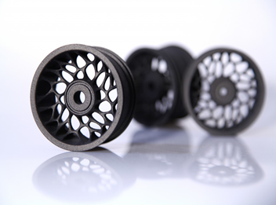
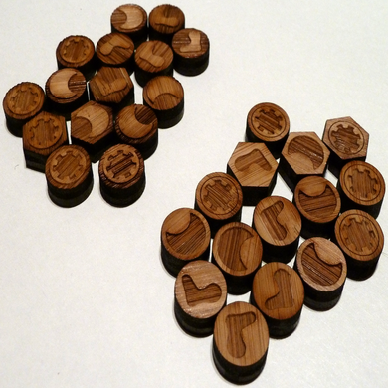
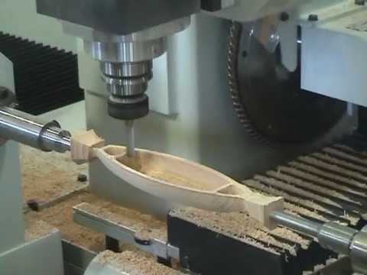
Problem
What if you are tasked with creating three different objects that are to be 3D Printed, Lasered, or even Milled.
However, you wanted to avoid the hassle of learning & using a machine
3D Printed Wheel
Laser Designed Pieces
CNC Milled Wood Piece
Notes:
*Explain what are they?

Slide 3
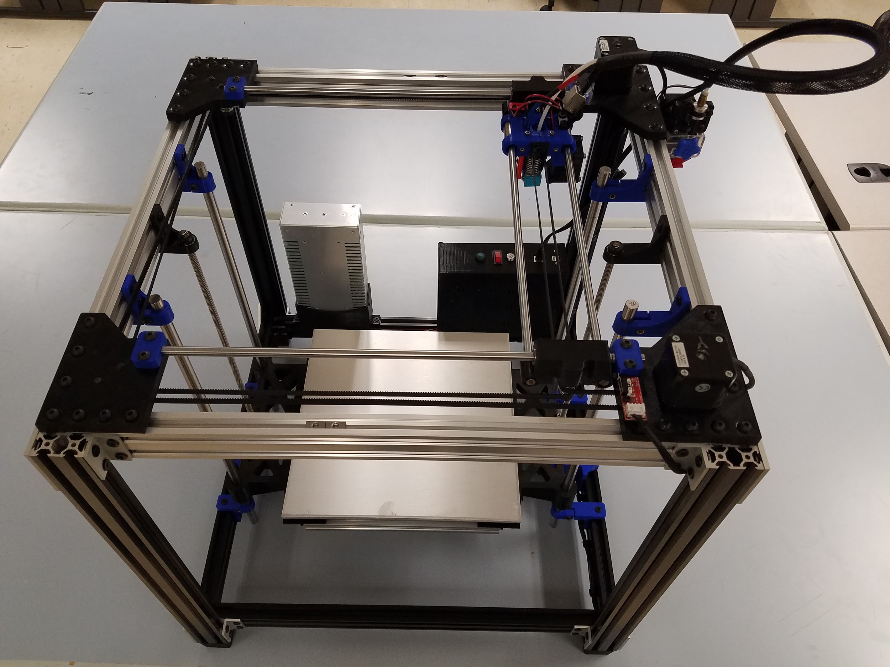
Solution
We present you a 3in1CNC Machine which focuses on the user experiences.
These three (pictures) are normally made from 3 different machines…
Now what if we told you that these all can be made from one machine, the Craft Cube.

Slide 4
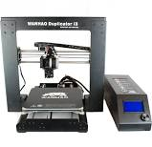
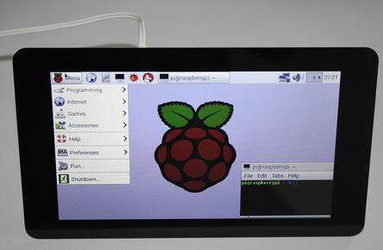
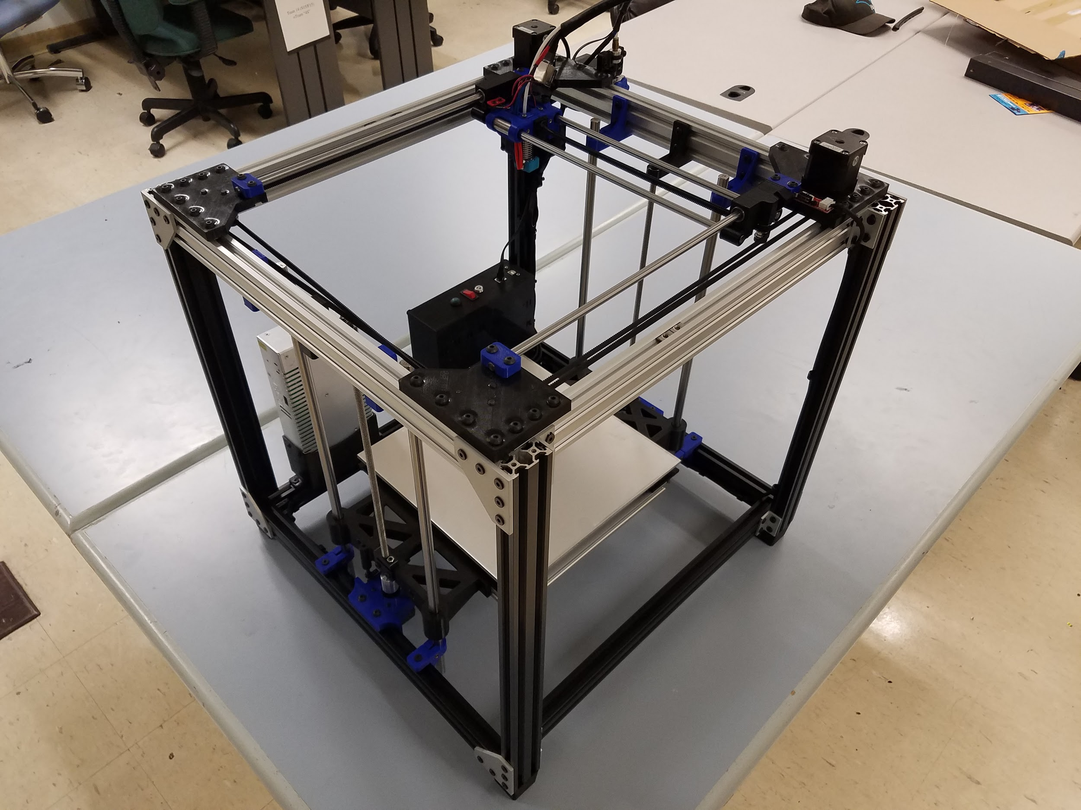

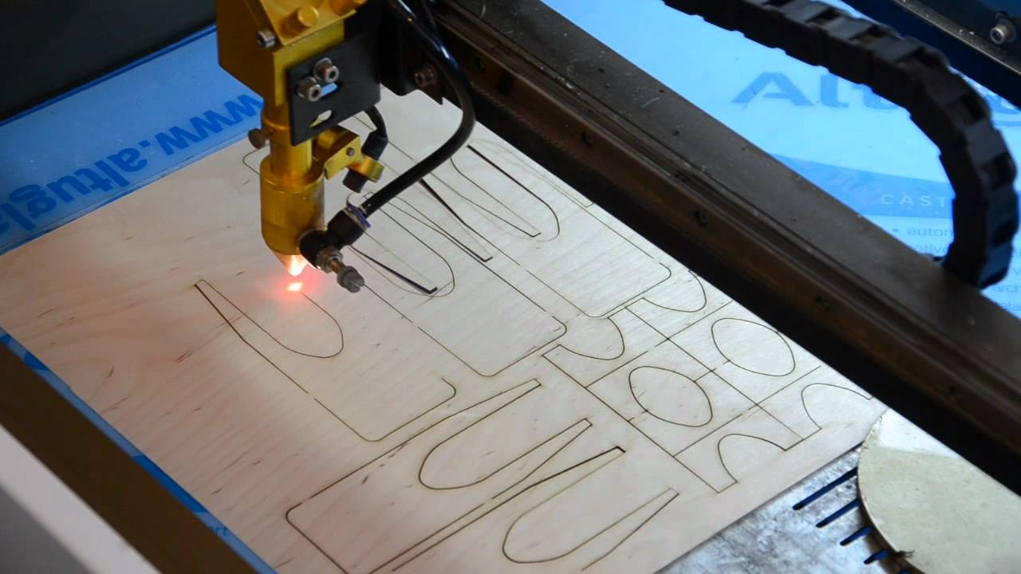
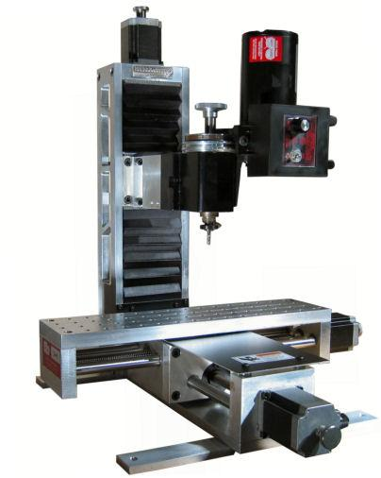
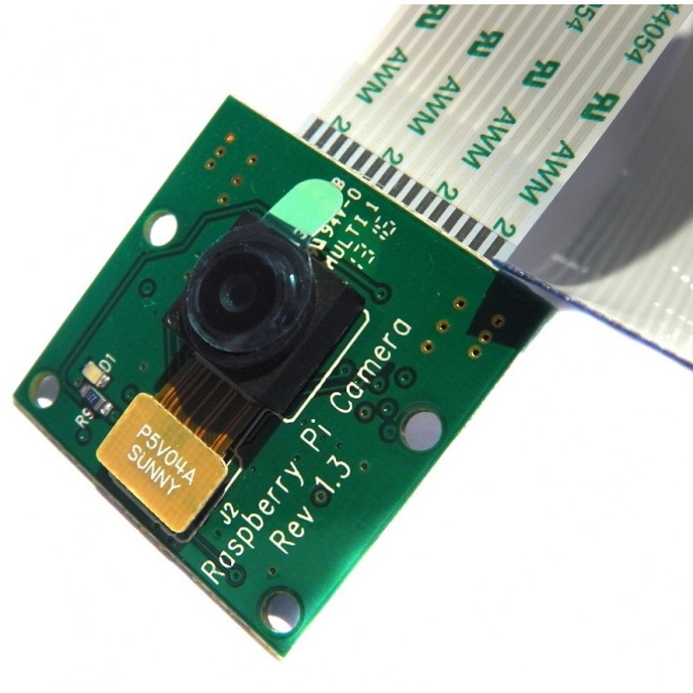
Key Features
Touch Screen
Network Capabilities
Craft Cube
Camera System

Slide 5
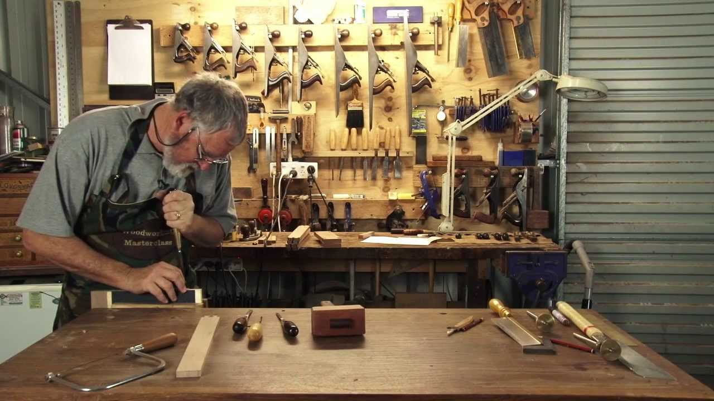



Target Market
Craft/Hobbyist
Educational Purposes
Small Businesses
Artistic Designs

Slide 6
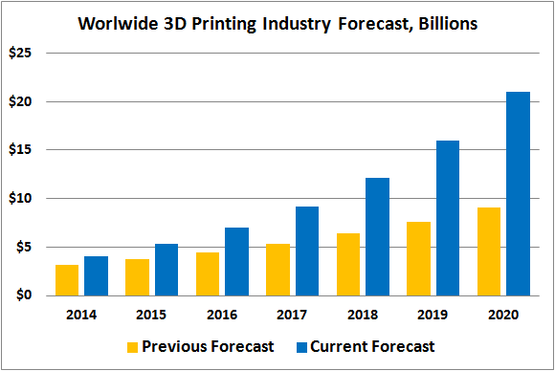
Market Size
The hobby level 3d printing market is $5.1 B.
According to Wohlers Report 2016, the 3D printing industry grew 25.9% (CAGR – Corporate Annual Growth Rate) to $5.165 billion in 2015.
It is expected to grow from $3.07B in revenue in 2013 to $12.8B by 2018, and exceed $21B in worldwide revenue by 2020.

Slide 7
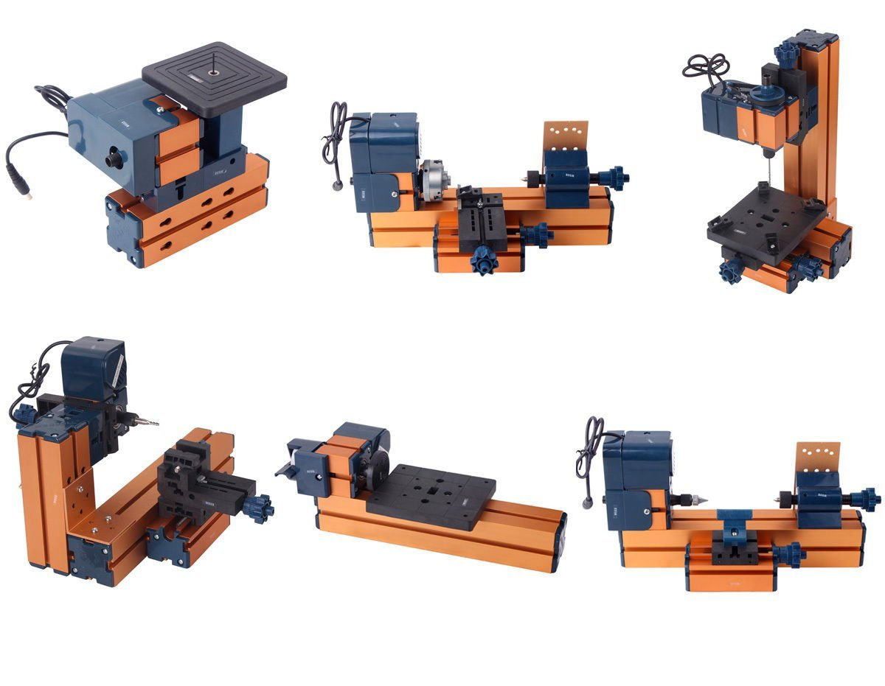


Business Model
Prototype Design Accomplishments
Create Business Partnership
Marketed Online
Marketed as a customizable kit or pre-built kit

Slide 8
Technological Feasibility
Features | Our Product | Trinus Deluxe | Da Vinci Jr. 1.0 3-in 1 | Glowforge Basic
Adjustable Working Space | ✔
Wi-Fi Connectivity | ✔
Phone App | ✔
Camera System | ✔
3 in 1 System | ✔
Touch Screen | ✔
Price | $950(Prototype Cost)

Slide 9
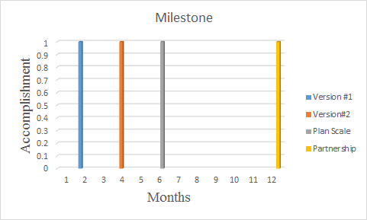
Developmental milestone

Slide 10
Business Proposal
Desirable Funds for production and marketing(estimated funds: 300K)
Projected 6-month design
Questions?

Slide 11
Conclusion
What are things you asking in this presentation (a very brief, in 10 seconds or less)?
We will need your help in order to continue working on the prototype and get it done within the next couple weeks.
Development stage

Slide 12
Why is our product/service/technology important or matter?
3D printing can create/build products that traditional manufacturing ways cannot do. For example: the nest ball
Laser cutter/engraver can go for a high-level precision design that none of the current products can go for.
It saves a lot of time and effort and cost for both hobbyist and business due to its fast and reliable features. Maybe example: traditional way for prototype is to send to somewhere and takes 4-8 weeks. With our product, maybe few hours.

Slide 13
1. What is your product/service/technology?
Our product is a 3 in 1 CNC machine that can be setup as a 3D printer, Laser engraver/cutter, and milling machine.
Made from easily sourced and 3d printed parts
Can 3d print in plastics up to 300*C
Can laser cut wood, plastics, foam, leather, paper
Can mill wood, plastics, other non metals

Slide 14
What are unique cores(difference to other equivalents) of your product/service/technology?
Ability to 3D print, laser cut, and mill in one machine
Can be sold as kit at a lower cost or sold as pre-built
Fully Customizable Size and Shape
Utilizes and supports open source hardware and software
Network connection through hardline or wifi
Camera system that helps in operating the machine
Easily controlled with a touchscreen and accessible through the internet from from a web page or phone app

Slide 15
Target Market
Craft/Hobby Enthusiast
Low Cost Projects (i.e. small businesses)
Educational Purposes
Artistic Designs

Slide 16
Market Size
The hobby level 3d printing market is $5.1 B.
The rate of growth:
According to Wohlers Report 2016, the 3D printing industry grew 25.9% (CAGR – Corporate Annual Growth Rate) to $5.165 billion in 2015. More than 278,000 desktop 3D printers (under $5,000) were sold for the year 2015. It is expected to grow from $3.07B in revenue in 2013 to $12.8B by 2018, and exceed $21B in worldwide revenue by 2020.
The hobby level laser engraver/cutter and milling market is not defined yet. They are mostly sold as a DIY kits for students or universities or even at hobby level.
(T): - Both hobby and industrial level
Laser cutters, 3d printers and mills have been sold world wide.
For hobby level, the users can be approached by the flexibility and user-friendly features
For industrial level, the business can be approached by the convenience and cost-saving that the products can save

Slide 17
Business Model
How much is the prototype cost?
How much would it cost to manufacture 100 units? (Estimation)
How much we are selling it for?
How much our competitor selling it for? (name two products)
What is the profit we are making per unit? And total?
Contractor? Make it yourself? ...etc

Slide 18
Technological Feasibility
How easy for us to manufacture?
Parts?
Models for the parts ready. Needs a scale up to produce multiple unit.
Hardware?
Software?
Features?

Slide 19
Developmental milestone
How far are we from the full product?
Prototype (In Progress):
3D printing
Laser engraver/cutter
Mechanics
Camera system
Touch screen control
Next:
Milling
Wi-Fi connectivity
Phone app

